Slide 1



Tiling Landsat Data for ABoVE
Damien Sulla-Menashe, Chris Holden, Curtis Woodcock, and Mark Friedl

Slide 2
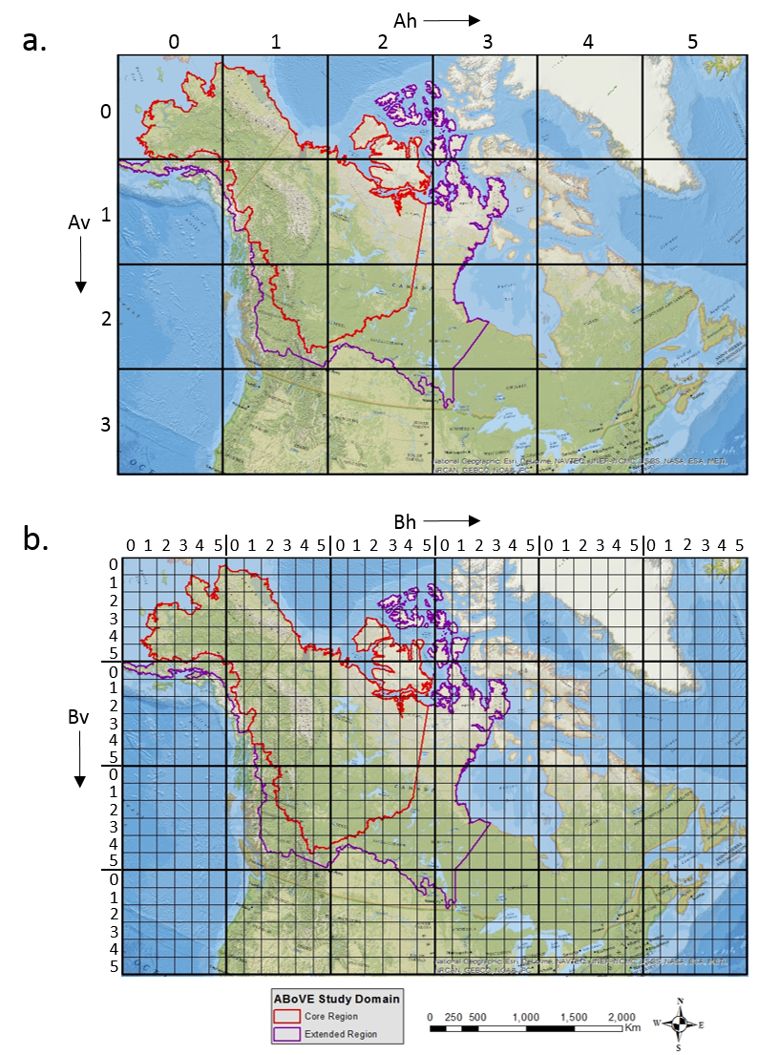
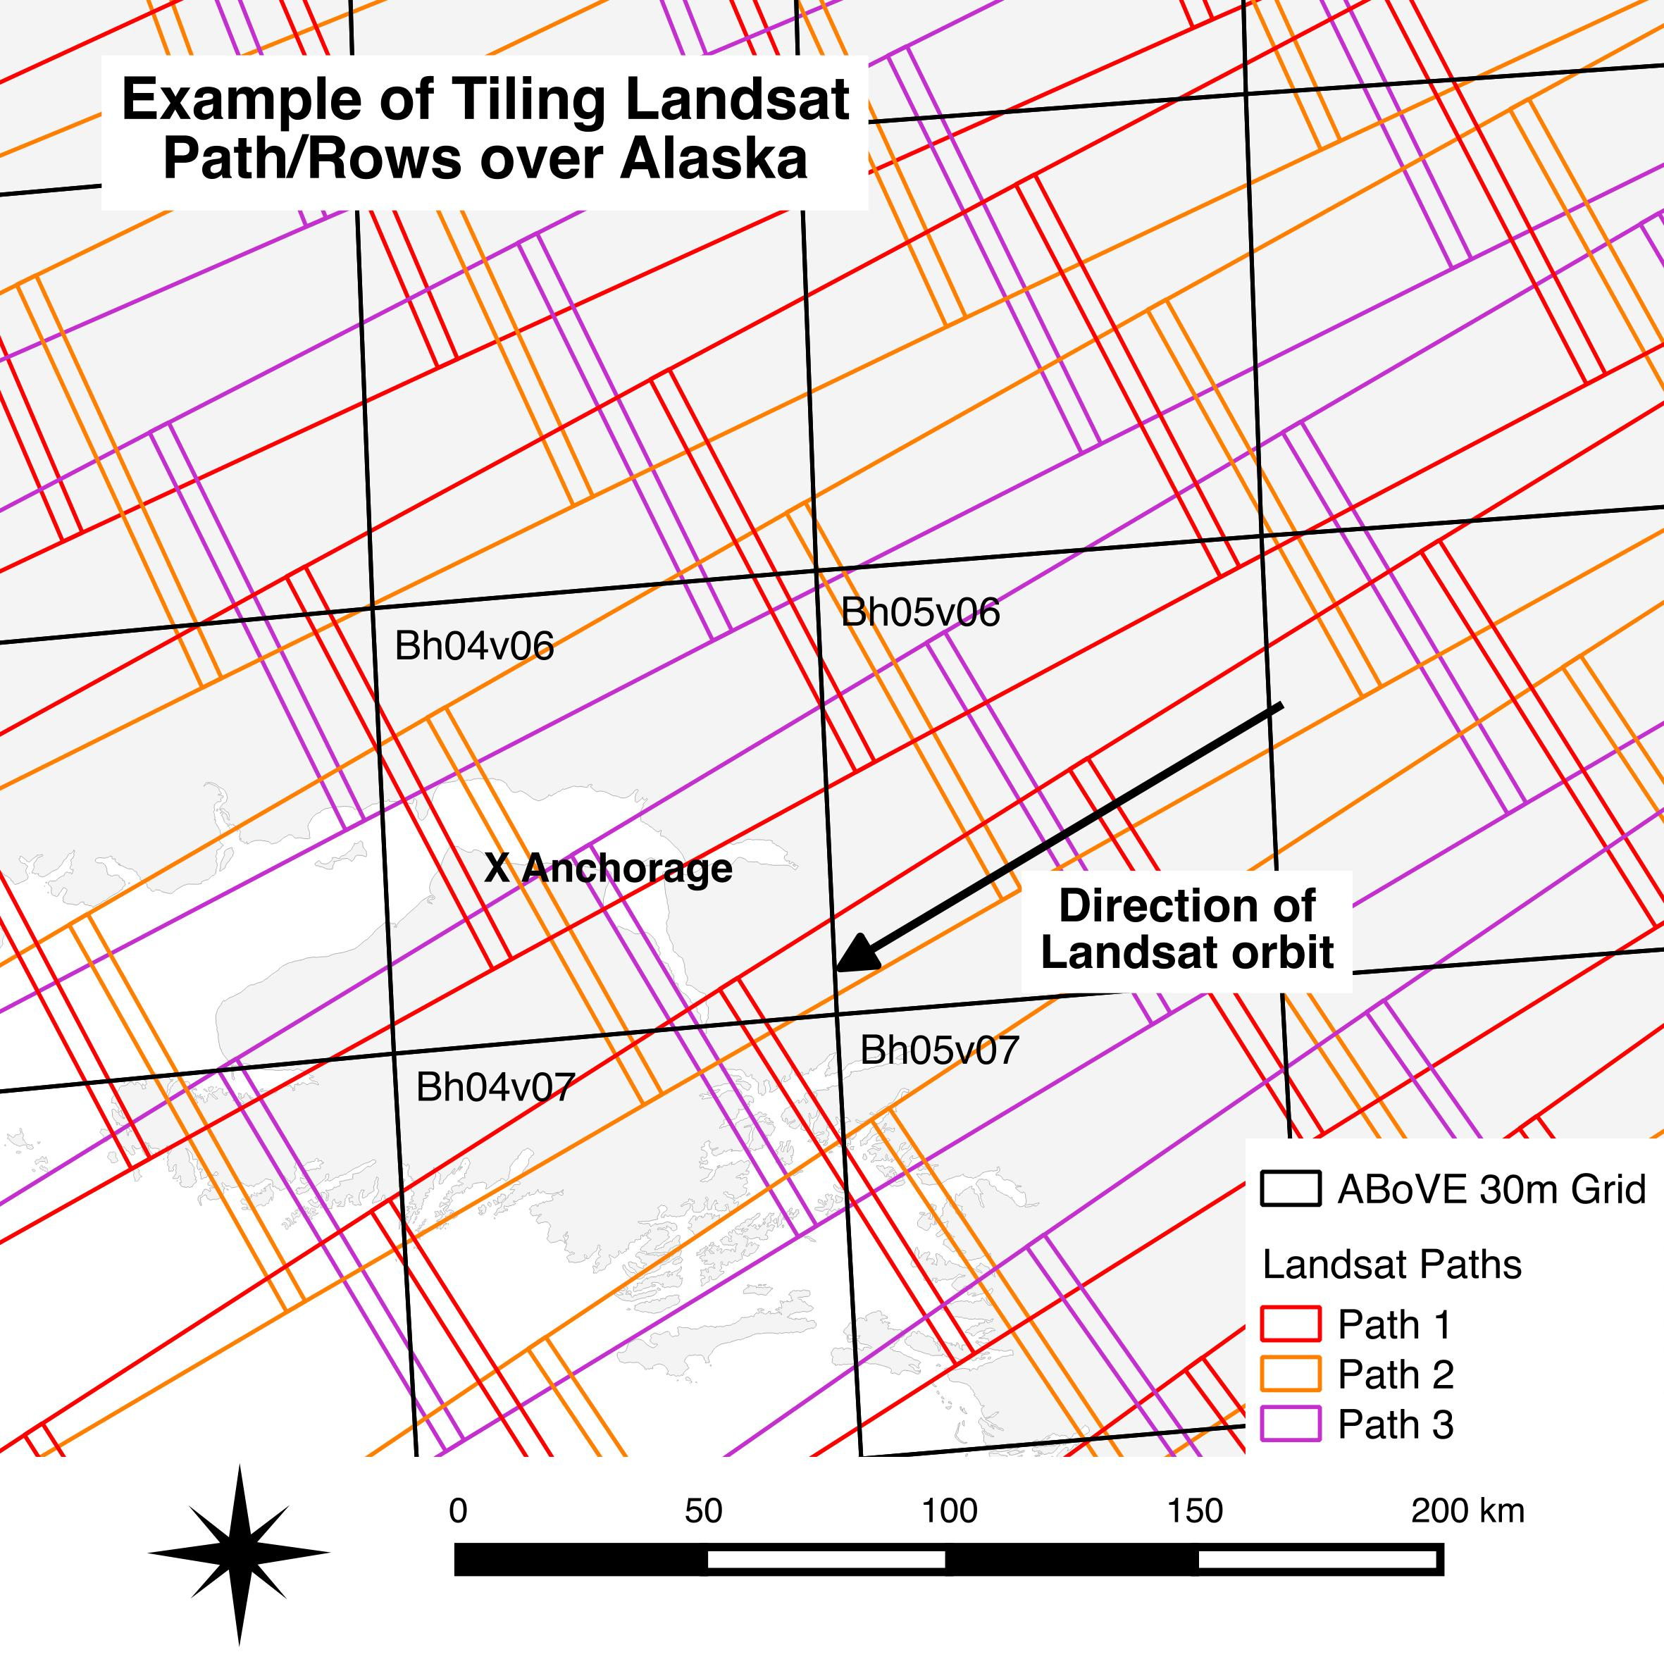
Why do we need to tile all these data?

Slide 3
Progress so far
A total of 437,826 images corresponding to 1271 individual path/rows were ingested between September and December of last year.
Input HDF files used up 102 TB disk space. Outputs/intermediate TIFF files used up 82 TB disk space.
 | TM5 | ETM | Combined
Total scenes ingested | 267,929 | 169,897 | 437,826
Total tile files produced | 1,136,321 | 504,607 | 1,640,928

Slide 4
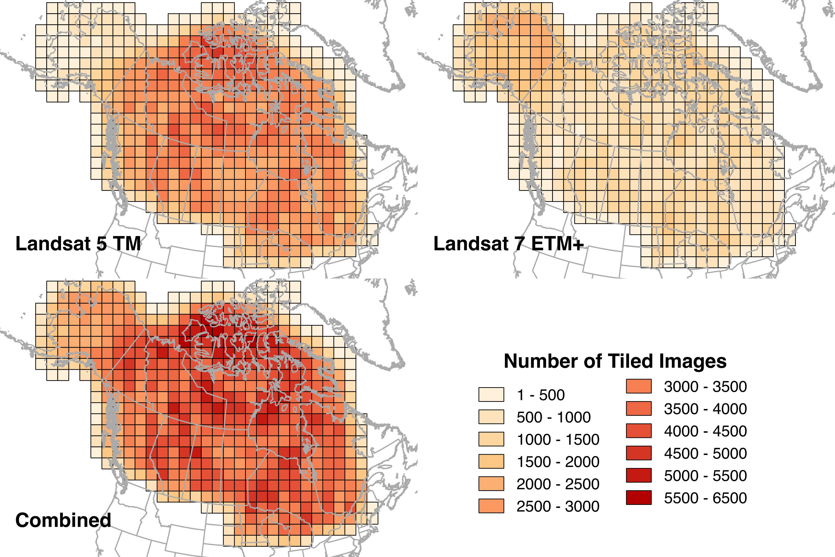

Slide 5
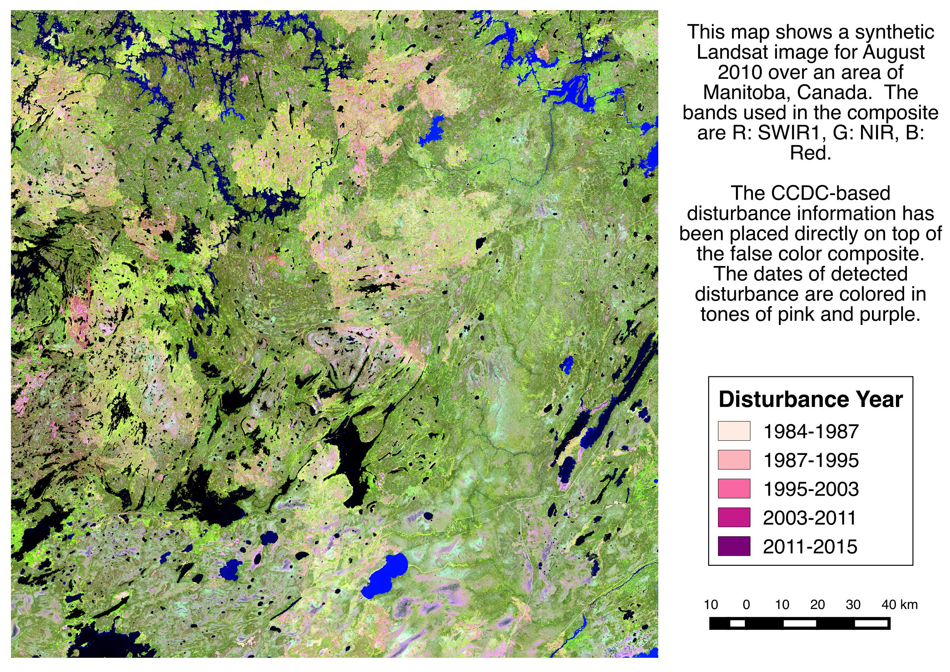
3500 images went into making this single composite!

Slide 6


Slide 7
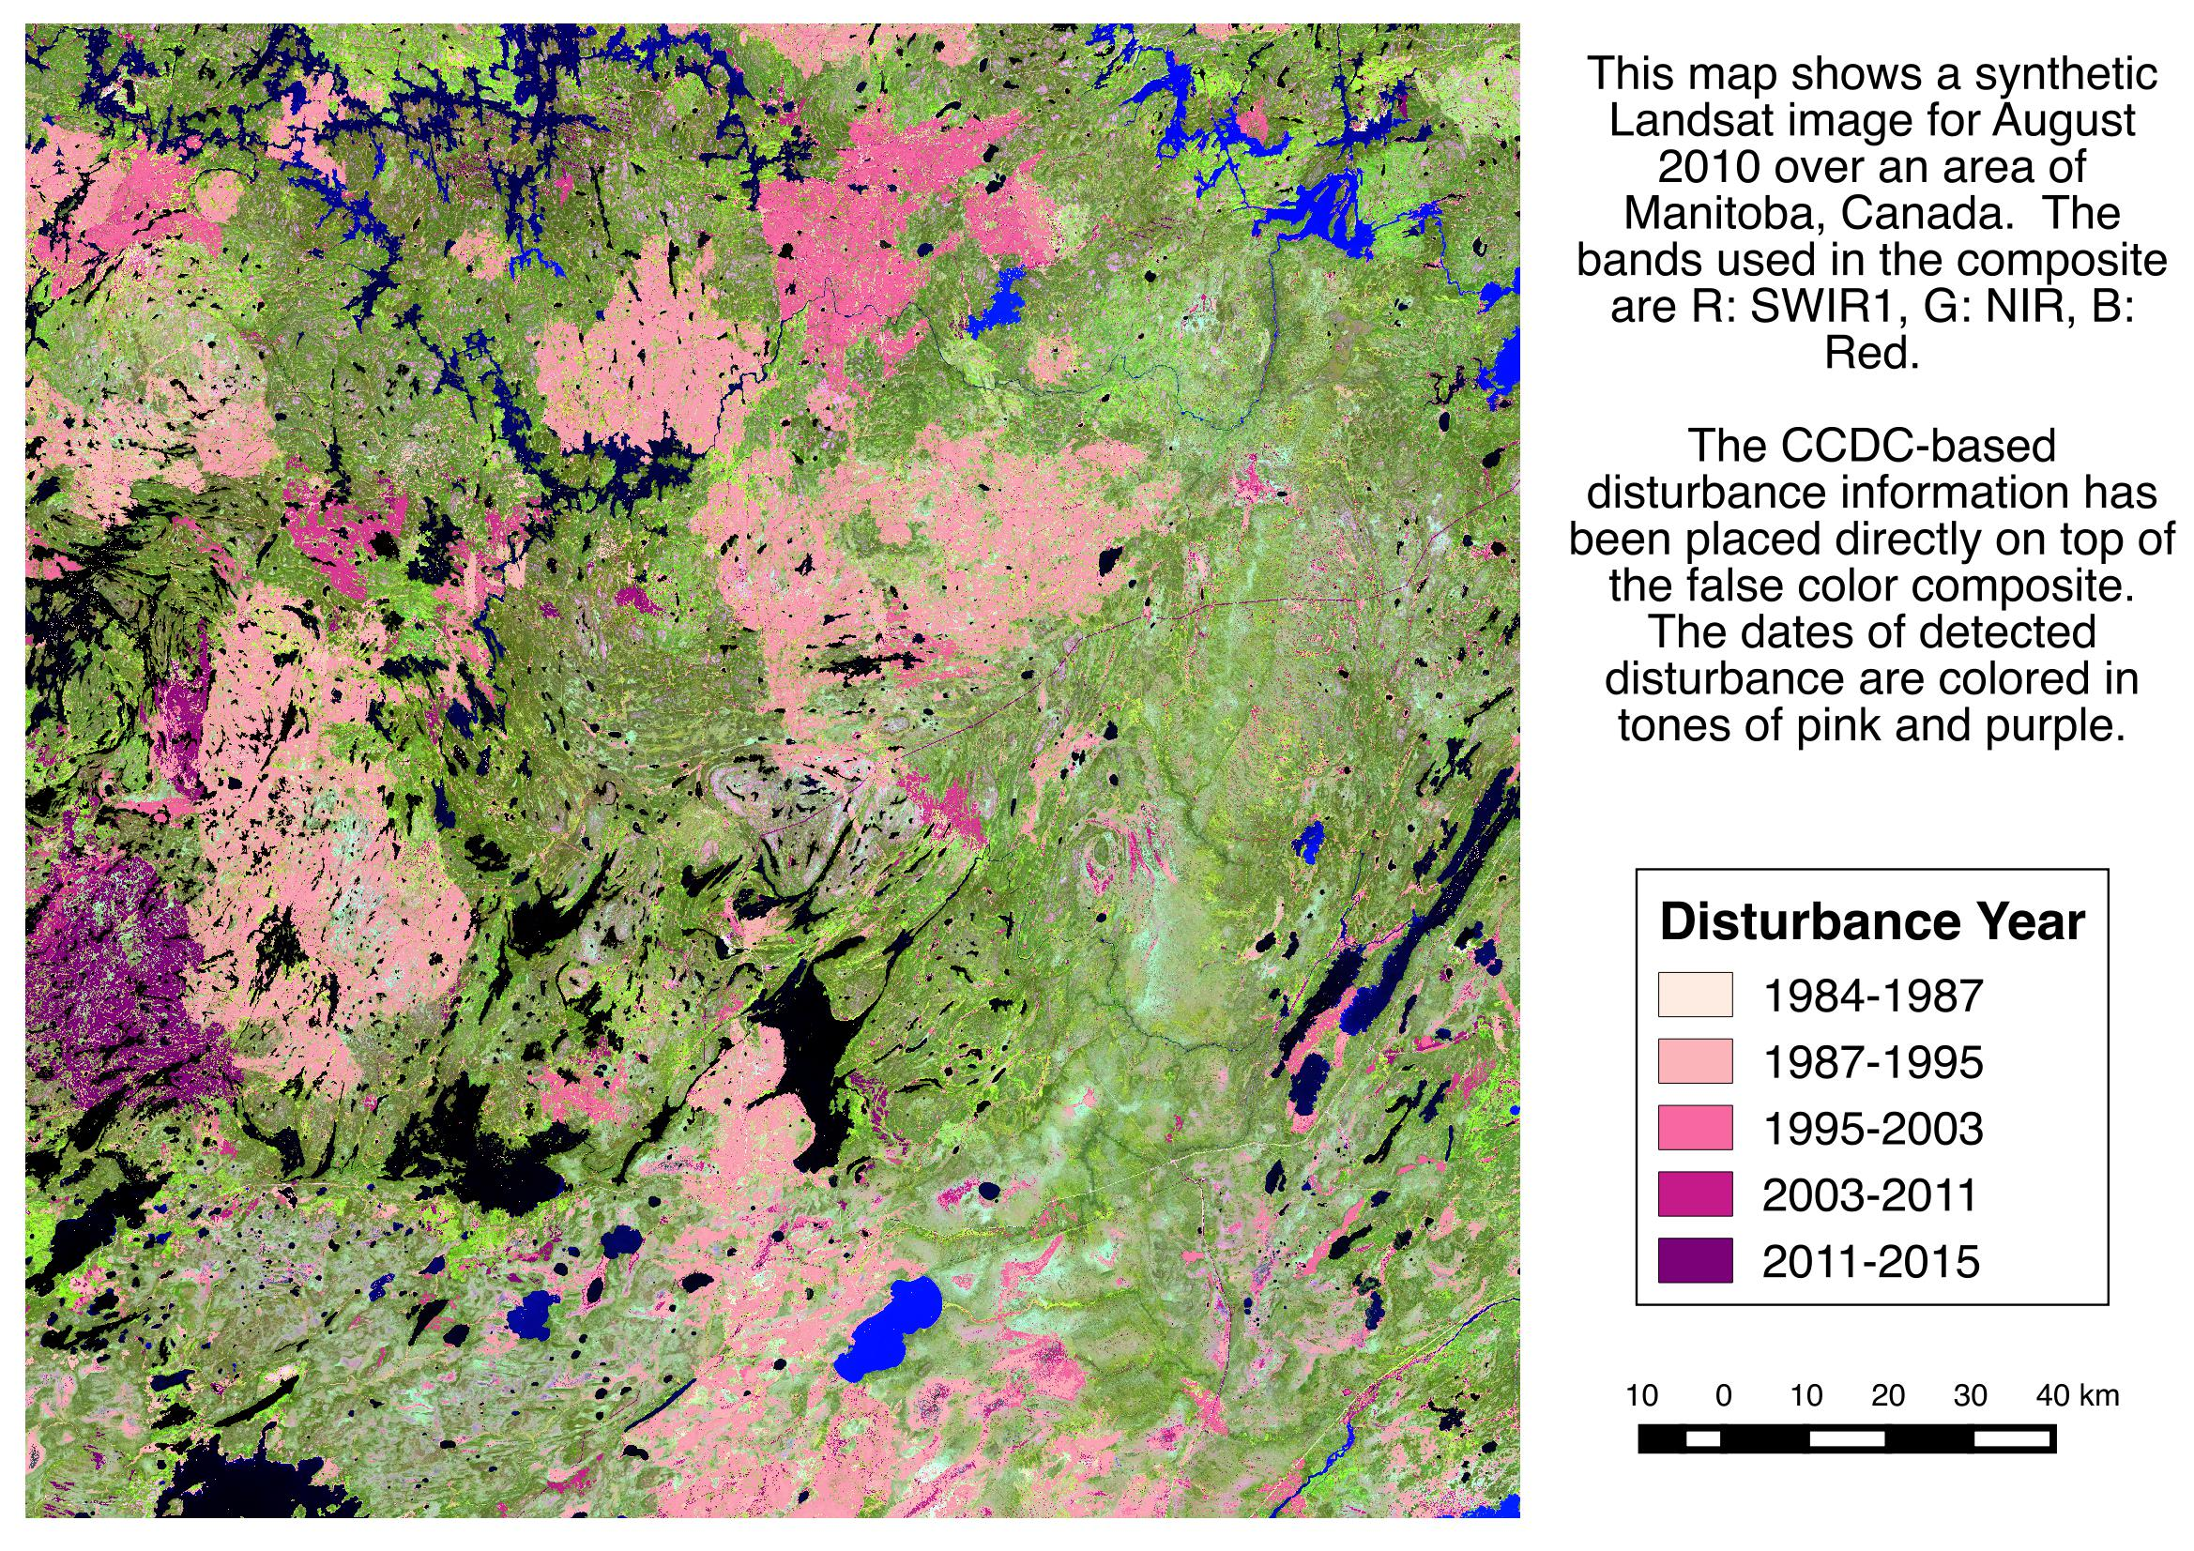

Slide 8
